Slide 1
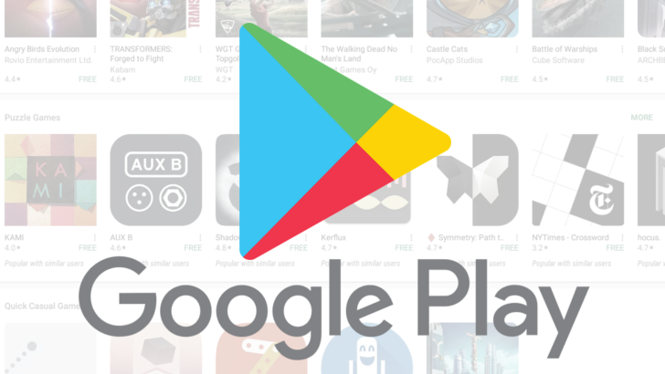
Analysis of Google play store

Slide 2
Problem
We focus on analyzing Google Play, the largest Android app store that provides a wide collection of data.
Such like Apps names, rating, reviews and much more.

Slide 3
Data
From Kaggle.com
dataset of
10842 rows 13 columns it consists 13 attributes which are: App, Category, Rating, Reviews, Size, Installs, Type, Price, Content Rating, Genres Last Updated, Current Version, Android Version.

Slide 4
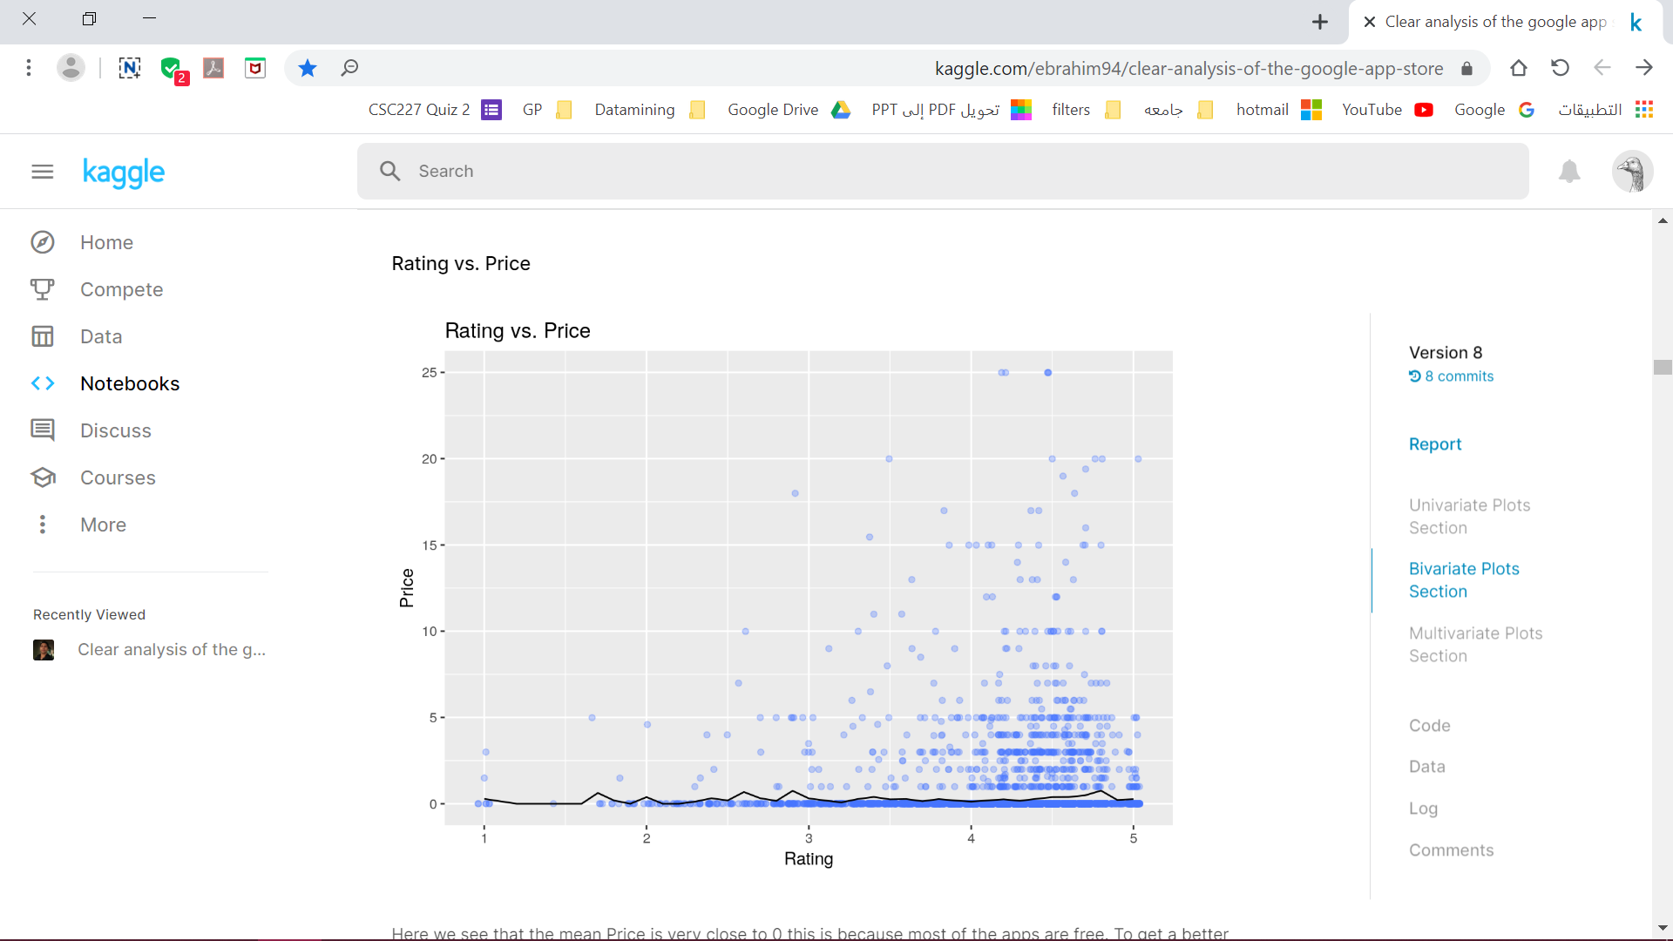
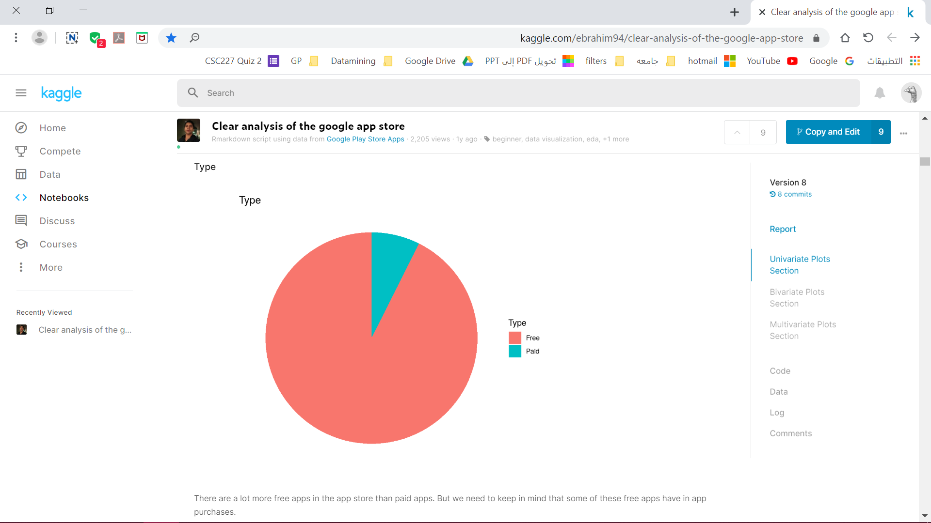
Data figures :
Rating vs. Price
Free vs. Paid

Slide 5
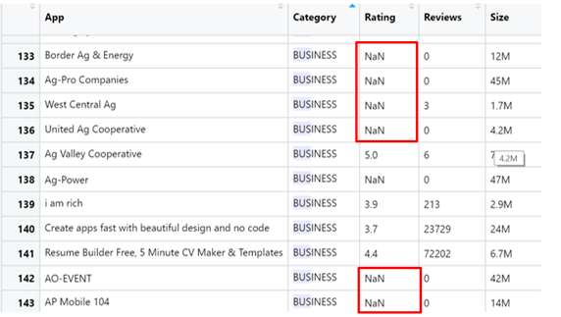
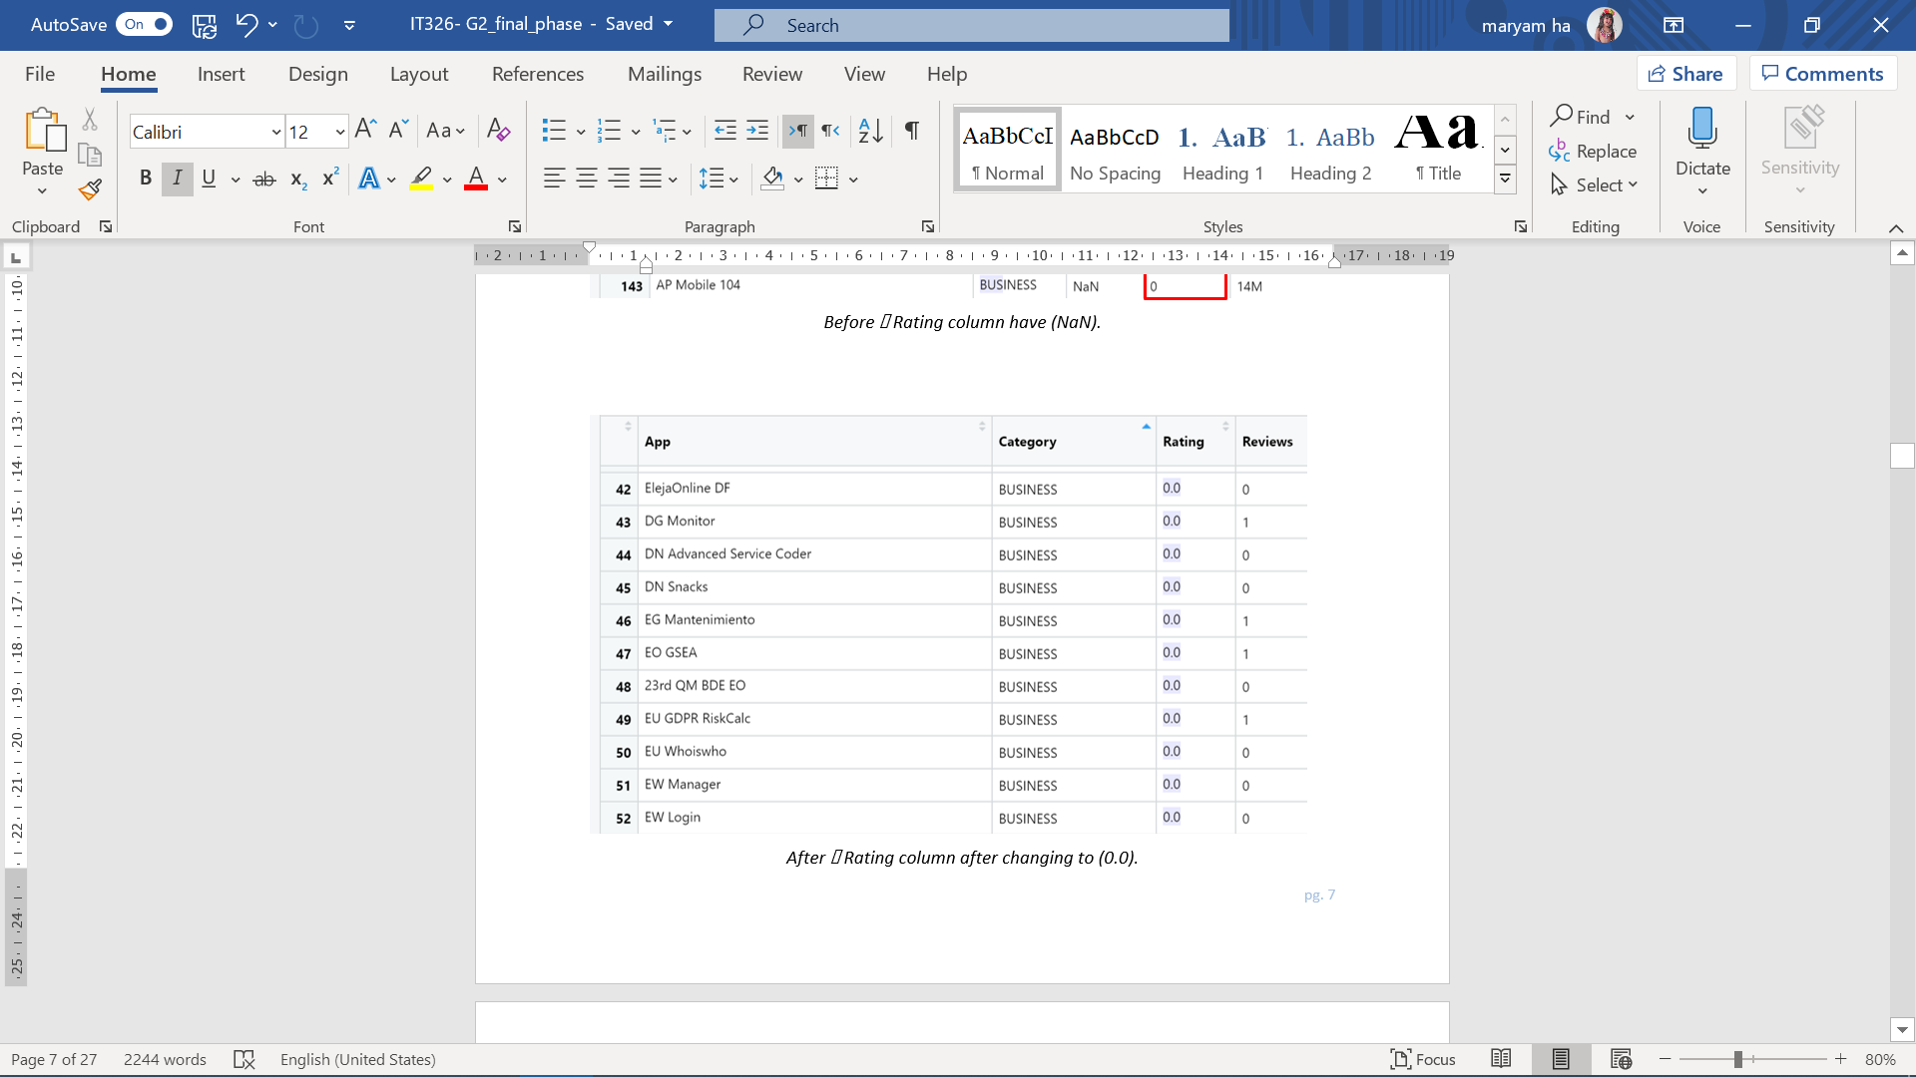
Data preprocessing
Replace missing values

Slide 6
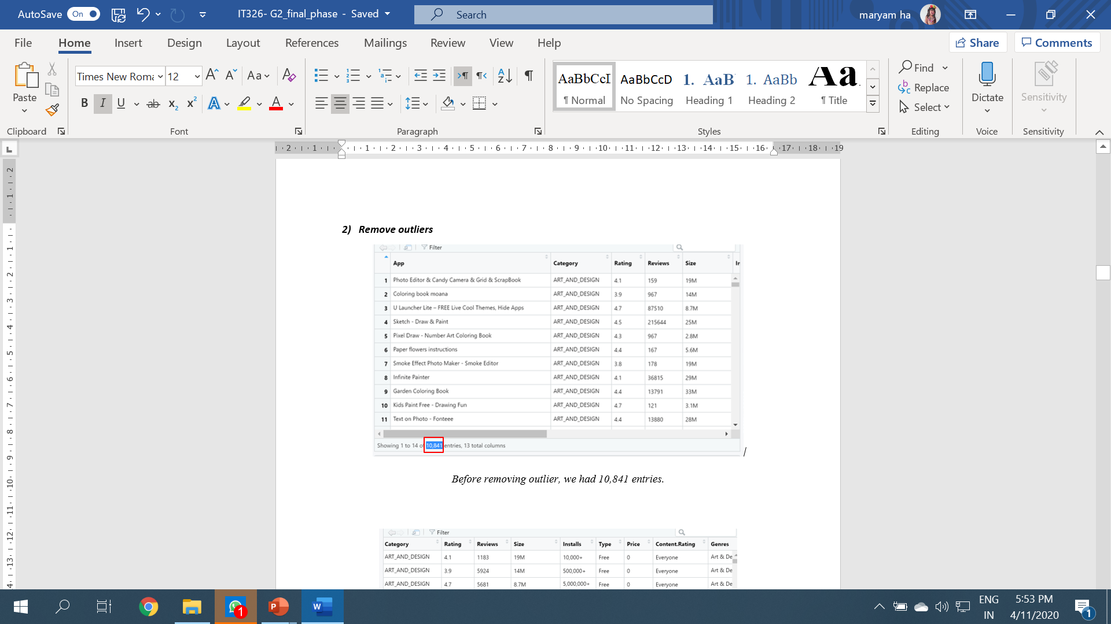
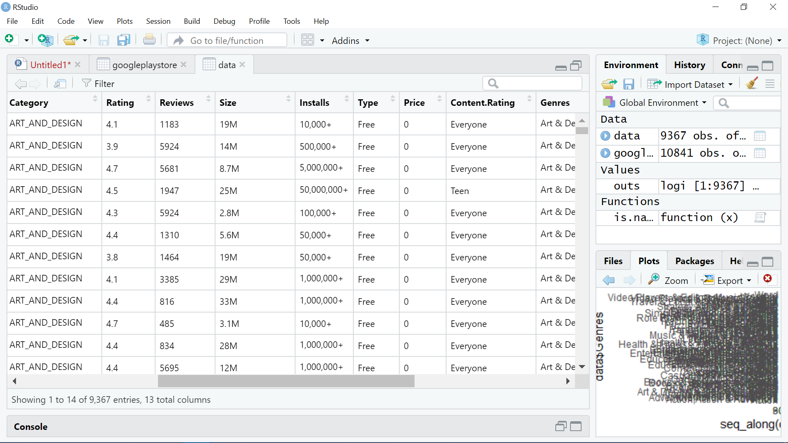
Data preprocessing
Replace missing values
Remove outliers

Slide 7
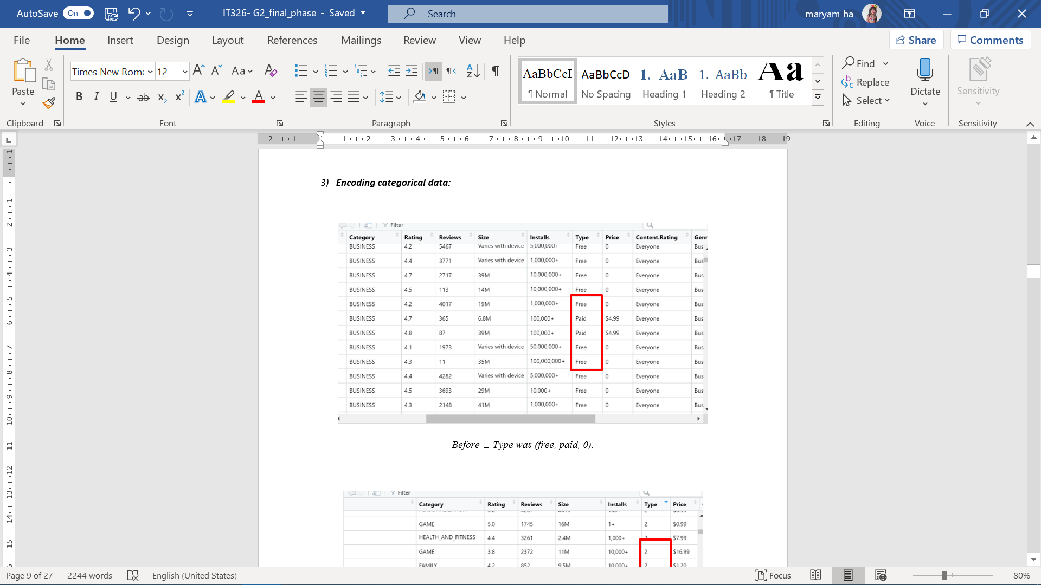
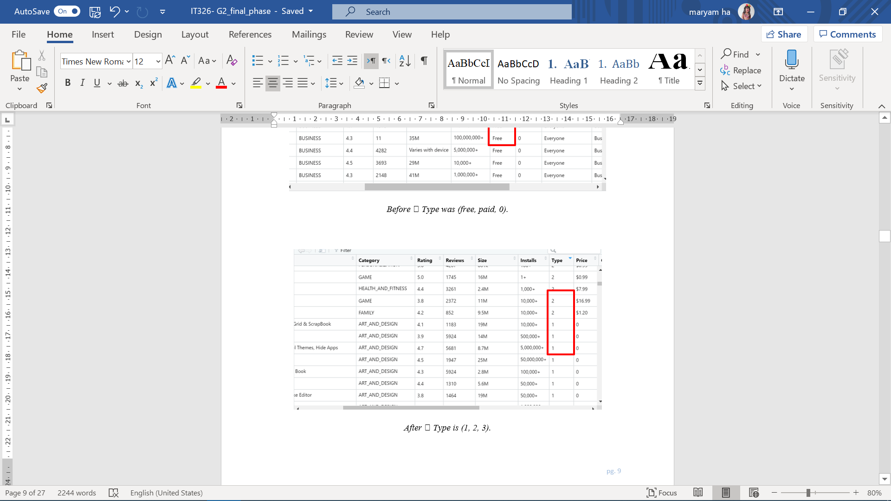
Data preprocessing
Replace missing values
Remove outliers
Encoding categorial data

Slide 8
Data Mining Technique
Clustring
Clustering is an information retrieval technique that puts
the items physically together, which are logically similar.

Slide 9
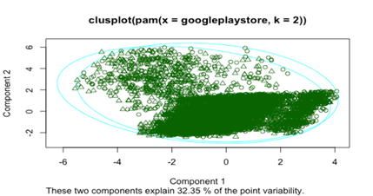
Clustring
Silhouette width for each cluster

Slide 10
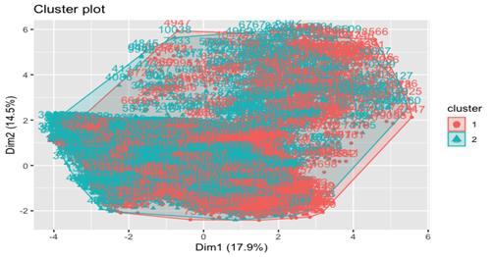
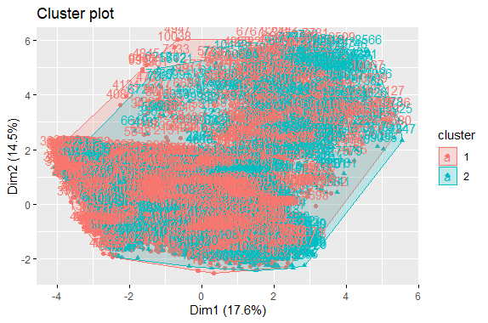
2-Clusters
Silhouette width for each cluster
Visualization pam
Visualization k-mean

Slide 11
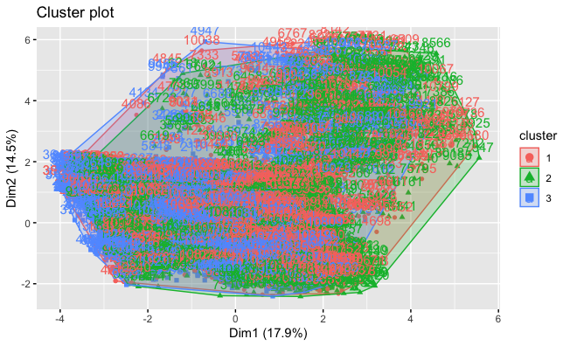
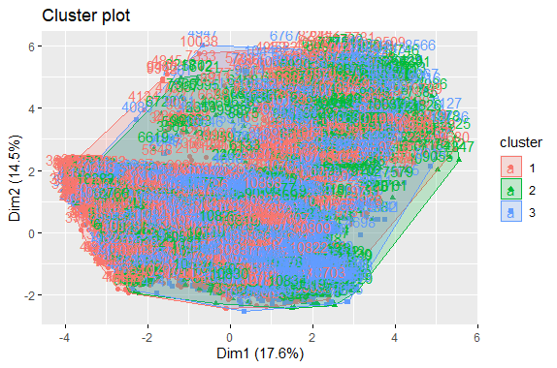
3-Clusters
Silhouette width for each cluster
Visualization pam
Visualization k-mean

Slide 12
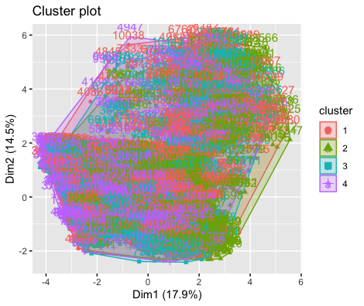
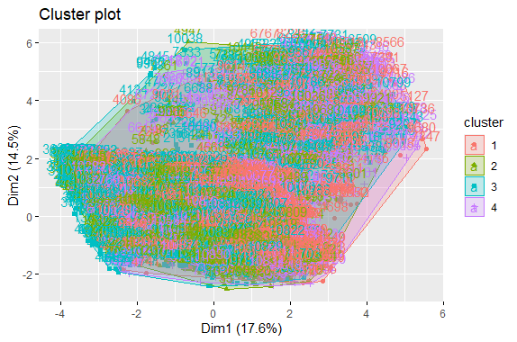
4-Clusters
Silhouette width for each cluster
Visualization pam
Visualization k-mean

Slide 13
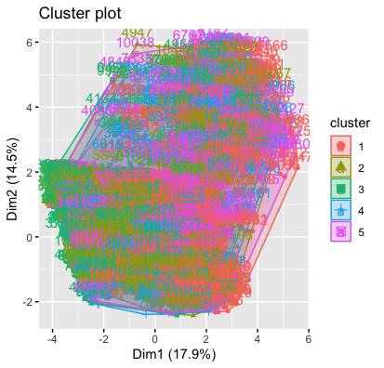
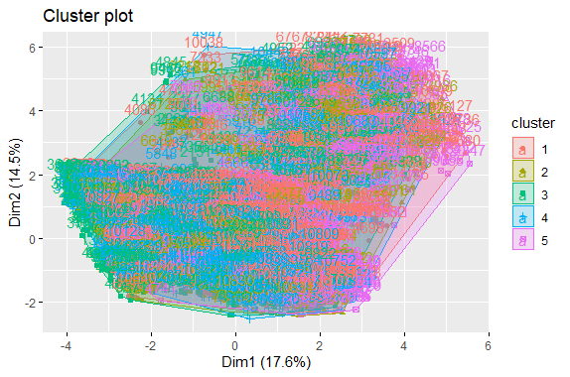
5-Clusters
Silhouette width for each cluster
Visualization pam
Visualization k-mean

Slide 14
In all clusters there is no much difference between K-means and K-medoids(pam).

Slide 15
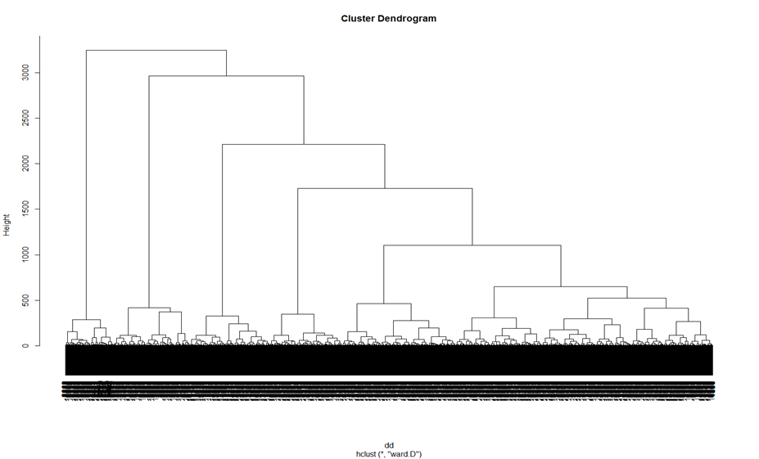
Extra Clusters
First Method

Slide 16
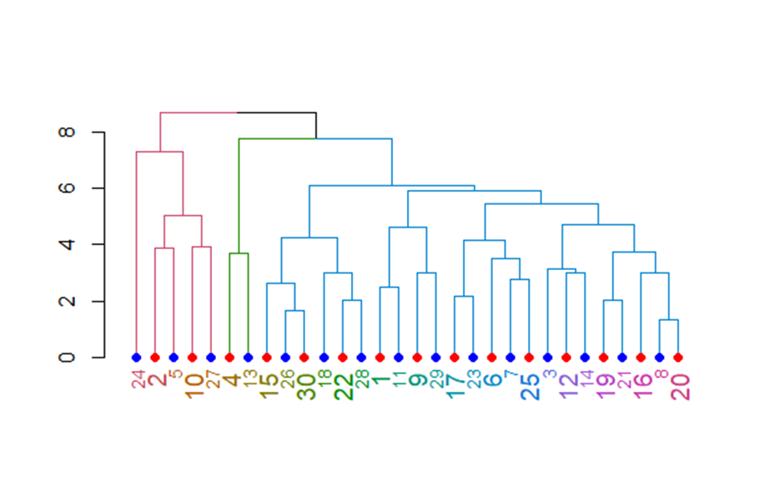
Extra Clusters
Second Method

Slide 17
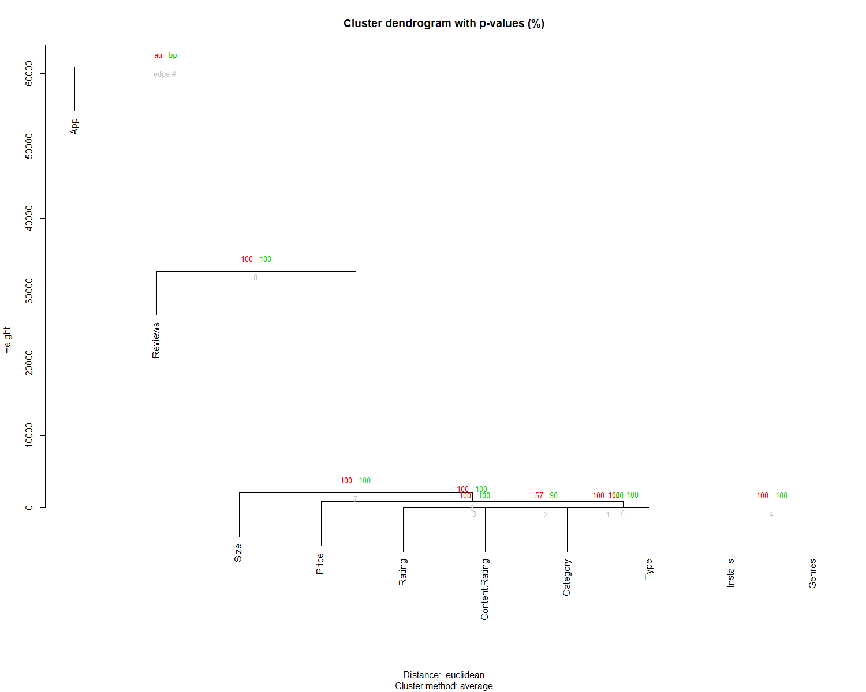
Extra Clusters
Third And Best Method
From these figure there is a strong association between Size ,Price ,Rating,ContentRating ,Category,Type,Installs and
Genres when the reviews and apps seems independent from the associated group
# plot the dendrogram in usual "base" plotting engine

Slide 18
Findings
We used 4 different clusters to find which one is the best, Since k=2 has the highest average which equals 39% means that it is the best cluster between all the clusters we create.

Slide 19
THANKS!

Slide 20
Done by:
ID | Name
Maryam AlAli | 436202235
Maha AlMutawaa | 438202246
Shahad alshabri | 438201590
Nura AlSubaye | 438202523

Slide 21
Resources
[1] our dataset
https://www.kaggle.com/lava18/google-play-store-apps/activity
[2] (PDF) Mining and analysis of apps in google play. Available
from: https://www.researchgate.net/publication/290102532_Mining_and_analysis_of_apps_in_google_
play [accessed Nov 24 2019].

